Slide 1



Digital Accessibility for ODL course notes
David McArthur, Craig Alexander, Colette Mair & Eilidh Jack

Slide 2
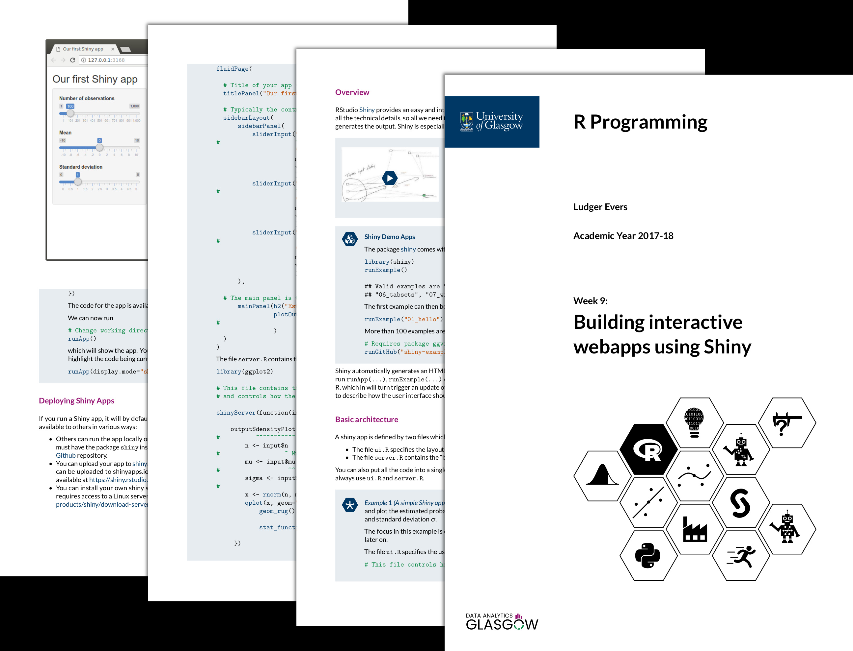
Learning materials for ODL – the past
Asynchronous content presented within PDF format.
Notes embedded with online Khan-style tutorials and tasks.
Older versions of the notes did not include any accessible features.

Slide 3
Learning materials for odl – the present
In order to meet the Public Sector Bodies Accessibility Regulations, the format of our course materials had to be updated:
Developed by ODL full stack web developer David McArthur.
Motivation to create accessible notes that do not just pass accessibility tests but cater for a variety of physical and cognitive disabilities.
Accessibility features can help everyone, from feedback, some students like to study on the go using mobile devices, using dark mode for viewing.

Slide 4
Our solution
Holistic approach, build accessibility in from the start:
Create features that are thoughtful, concentrate on simplicity instead of passing accessibility tests
Create features that can be useful for everyone— features that are widely used will be actively maintained and improved
Provide options rather than one-size-fits-all

Slide 5
Our solution
HTML > PDF for accessibility:
Wide selection of accessibility tools designed for HTML that work on all major platforms and devices.
Responsive - HTML can adapt to different sized screens to provide the clearest layout.
Opens the door to richer experiences such as interactivity and animation.
It’s possible to provide an accessible PDF derived from accessible HTML.

Slide 6
The html file
Self-contained - as portable as a PDF file and can be opened with any web browser.
Simple and distraction-free design.
Sidebar with Table of Contents to facilitate easy navigation.
A View Options pane allowing the user to change colour, spacing and sizes of the page content.

Slide 7
The html file
Responsive— adapt from the smallest mobile screens to largest desktop screens.
Answers next to tasks to avoid excessive scrolling.
Use Scalable Vector Graphics wherever possible to ensure graphics look crisp and in focus even when zoomed in.
Follow best practices for creating semantic, accessible HTML code.

Slide 8

Accessible latex
Convert LaTeX code to MathML using MathJax
<math> <mi>y</mi> <mo>=</mo> <mi>x</mi> <mi>&#x3B2;</mi> <mo>+</mo> <mi>&#x3B5;</mi> </math>
y = x\beta+\varepsilon

Slide 9
Accessible latex
Convert MathML to speech with Speech Rule Engine
<math> <mi>y</mi> <mo>=</mo> <mi>x</mi> <mi>&#x3B2;</mi> <mo>+</mo> <mi>&#x3B5;</mi> </math>
Y equals x beta plus epsilon

Slide 10
Accessible latex
Convert MathML to SVG using MathJax
<math> <mi>y</mi> <mo>=</mo> <mi>x</mi> <mi>&#x3B2;</mi> <mo>+</mo> <mi>&#x3B5;</mi> </math>
<svg> <path d="..."></path> <path d="..."></path> <path d="..."></path> <path d="..."></path> <path d="..."></path> <path d="..."></path> </svg>

Slide 11
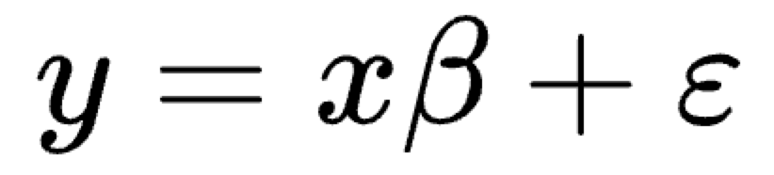

Accessible latex
Set the SVG title to the speech text, and tell assistive technologies to treat the SVG as an image with alt-text
<svg role="img" aria-labelledby="id1"> <title id="id1">y equals x beta plus epsilon</title> <path d="..."></path> <path d="..."></path> <path d="..."></path> <path d="..."></path> <path d="..."></path> <path d="..."></path> </svg>

Slide 12
The pdf file
Providing options - some users prefer a paper-like representation of course notes.
Chromium, the open-source foundation of the Chrome browser, can create an accessible “tagged” PDF from an HTML document
Task answers are moved to the end due to lack of interactivity.

Slide 13
Initial Student Feedback
Early student feedback to the new HTML accessible version of the notes has been positive.
“Cleaner and neat look”, “Task solutions attached to task saves scrolling”, “3-bar menu helpful for navigating sections”
Features such as theme and font size are used by students often.
Some helpful suggestions for development, such as copy/paste options for code blocks & facilities for note taking.
PDF notes still used by students for at-home study and note taking.

Slide 14
Future goals
Moving from a paper-like to a webpage-like medium opens the door to richer notes.
Explore communicating complex concepts in more intuitive ways.
This can also create new challenges for accessibility.

Slide 15
Future goals
Interactivity
A quiz embedded in the course notes, with score awarded in real time.
Plots where you can modify variables and see how it affects the plot in real time.

Slide 16
Future goals
Animation
Plots which evolve over time
Step through a complex process
Show the working of a mathematical problem

Slide 17
Thank you!
Any questions?

